Slide 1
Navigating the Arizona Website 2022-2024
Valdine Brower
Arizona Webmaster
2022-2024
https://www.arizonaalphadeltakappa.org

Slide 2
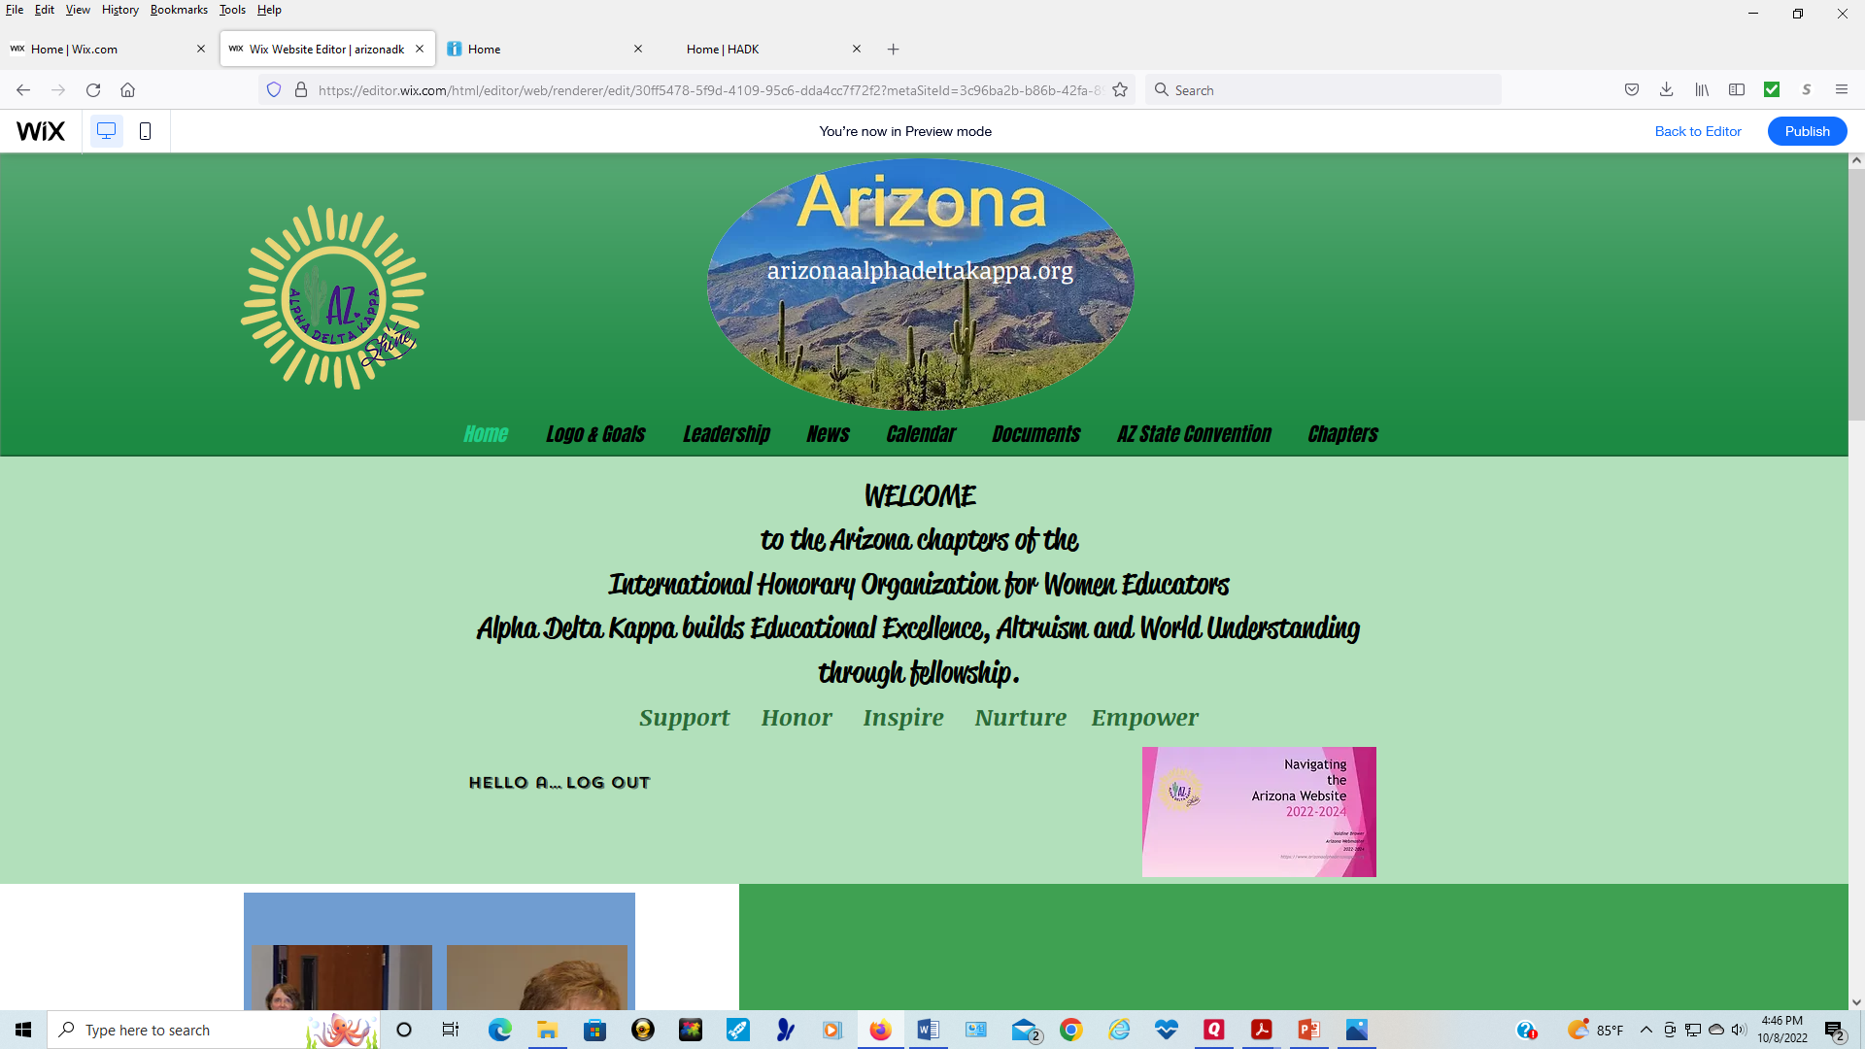
Arizonaalphadeltakappa.org Login or sign up to view pages.

Slide 3
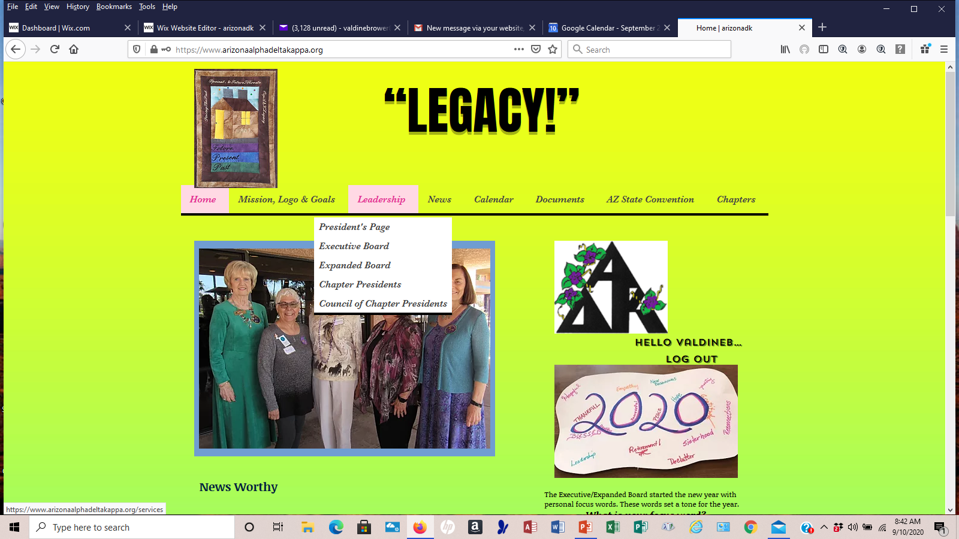
Don’t forget to sign in to visit the “Leadership” pages. They are password protected.

Slide 4
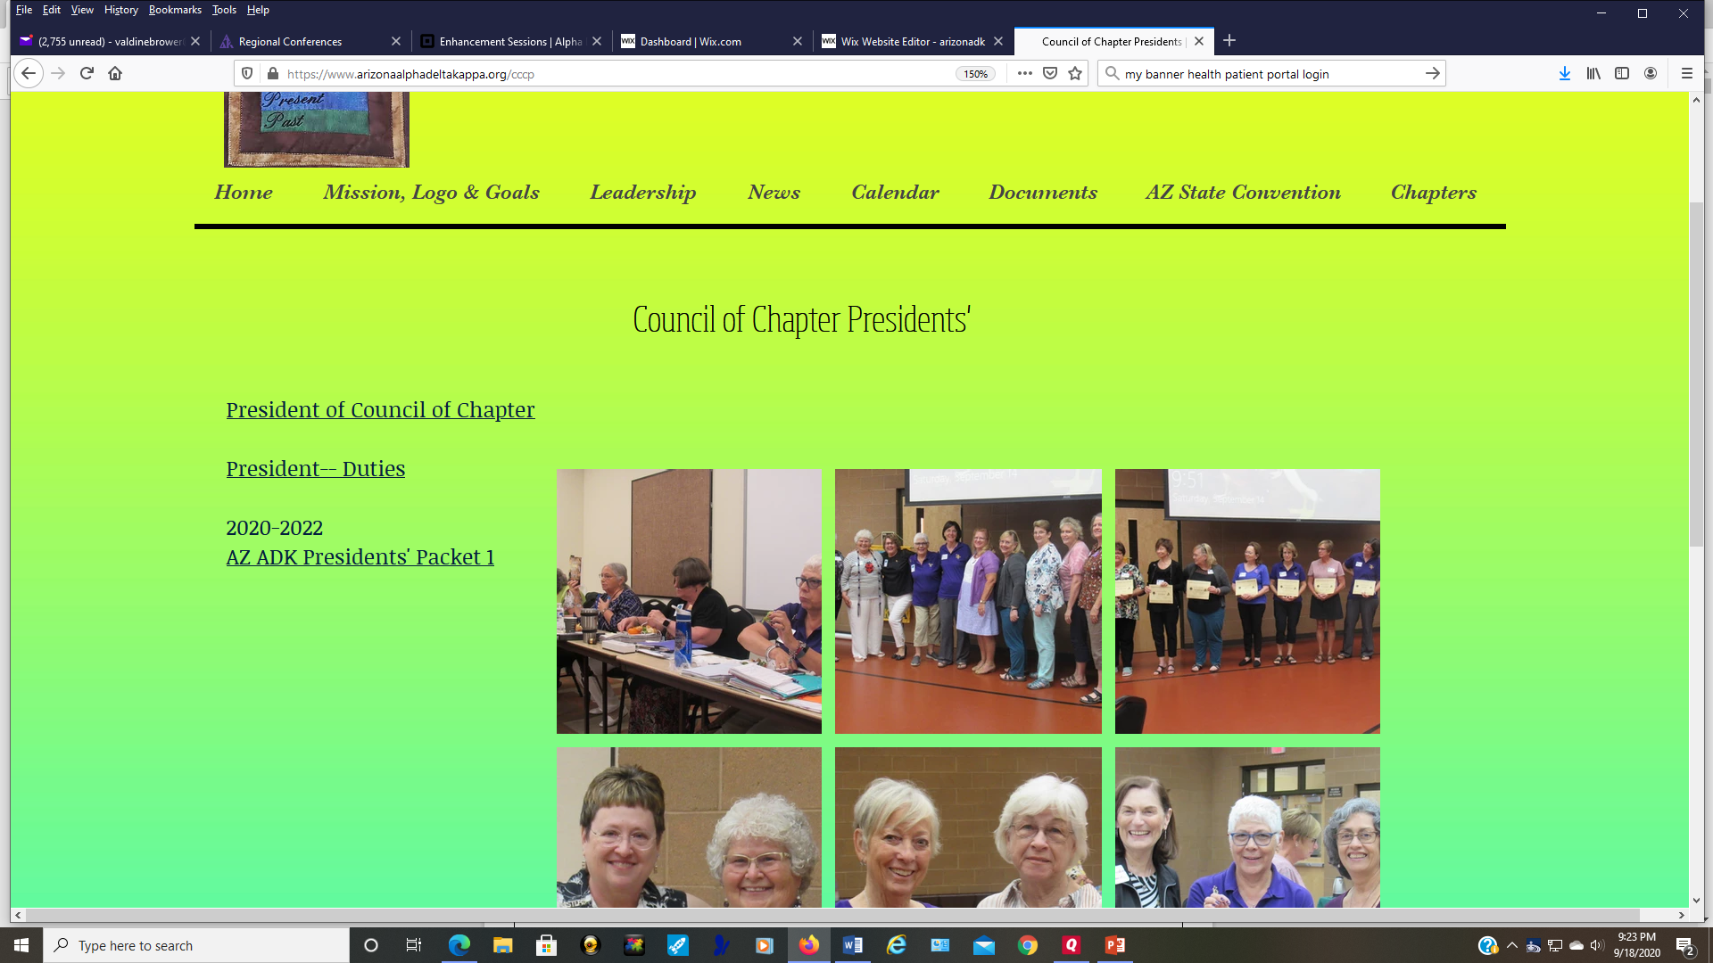
The Council of Chapter Presidents’ page will have all the documents from the CCP meeting.

Slide 5
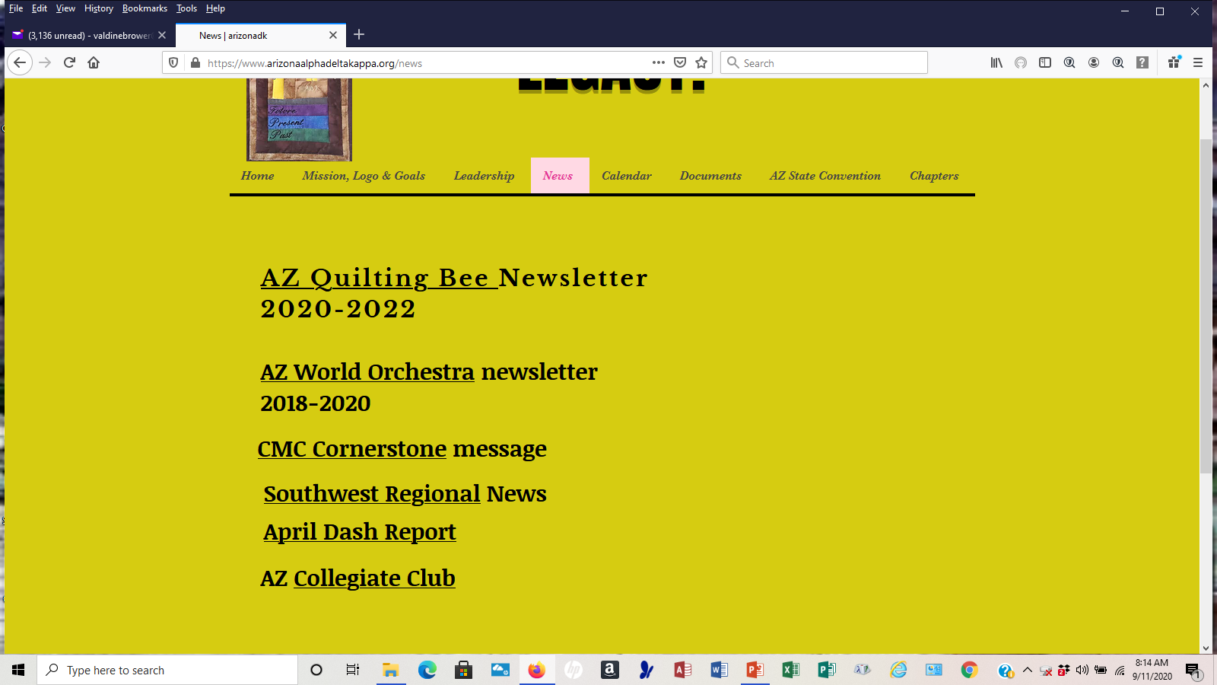
State and Regional News

Slide 6
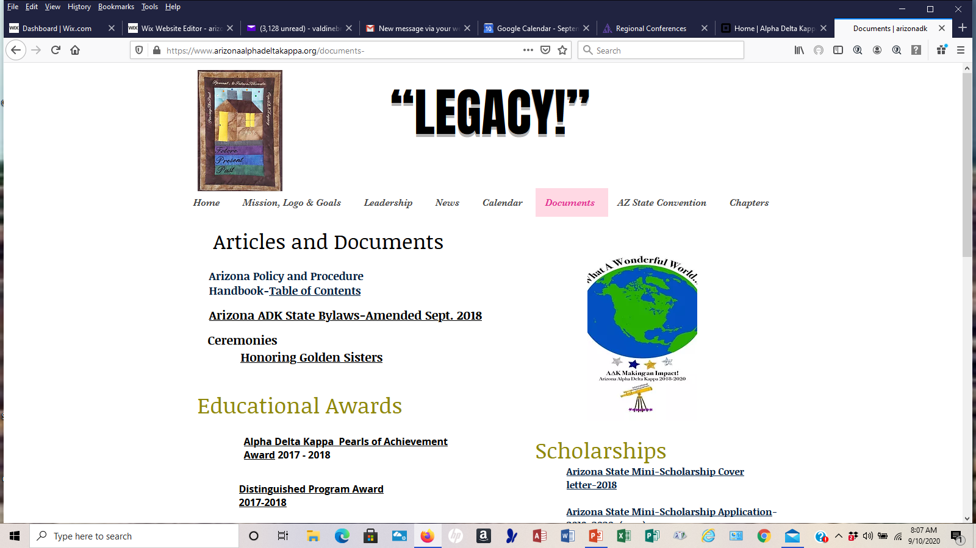
Updated documents are added as I receive them. Send them as Word Documents, they will be converted to PDF before they
are placed on the website.

Slide 7
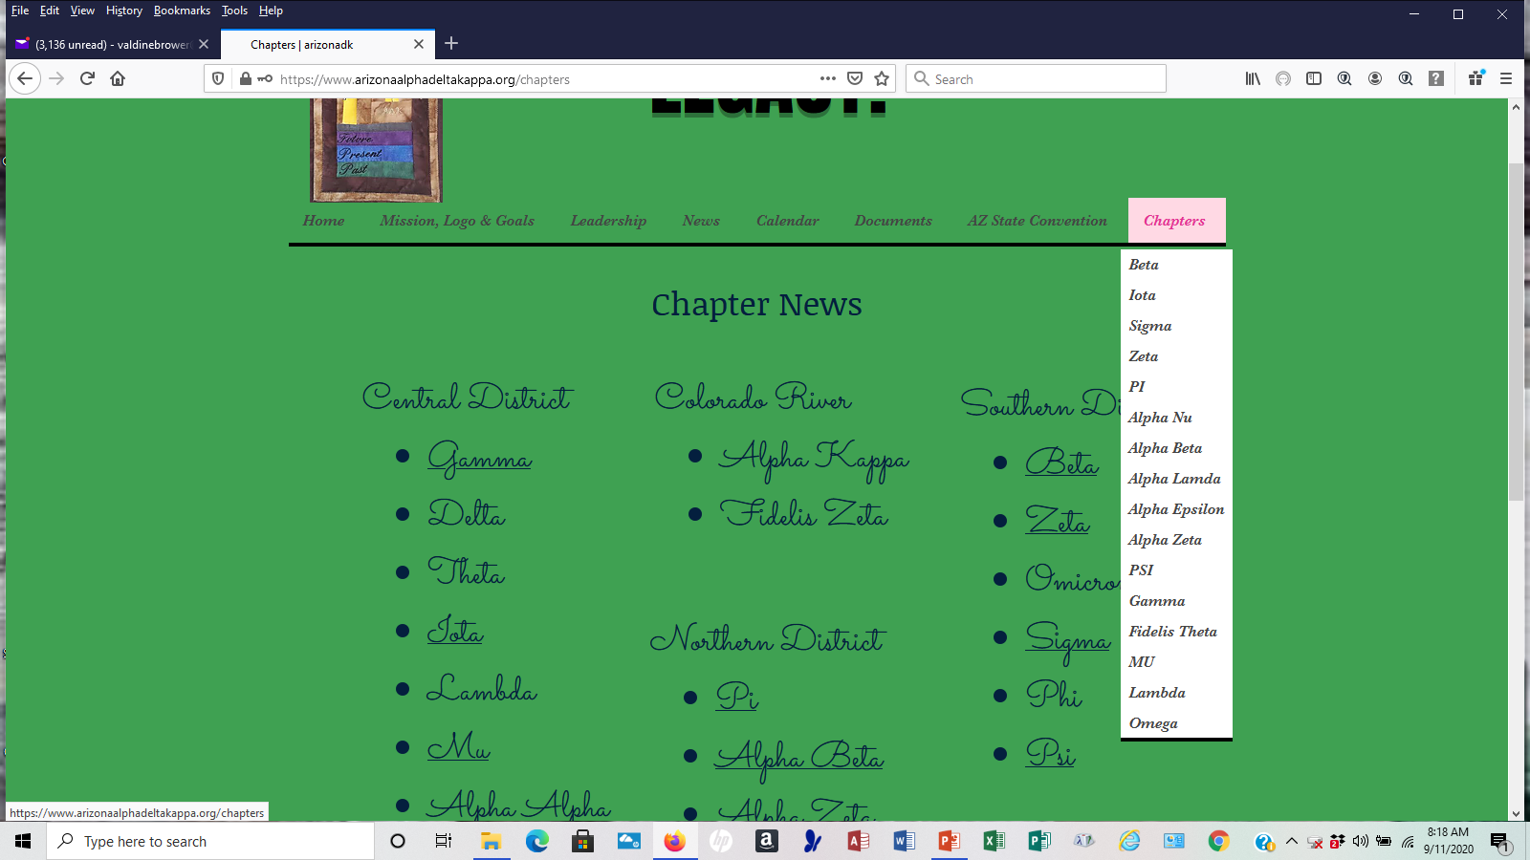
All AZ ADK chapters have a page where I can add documents, pictures, etc. Send pictures as jpg’s along with names if you wish
To identify the person. You will also find the Omega chapter ceremony here.

Slide 8
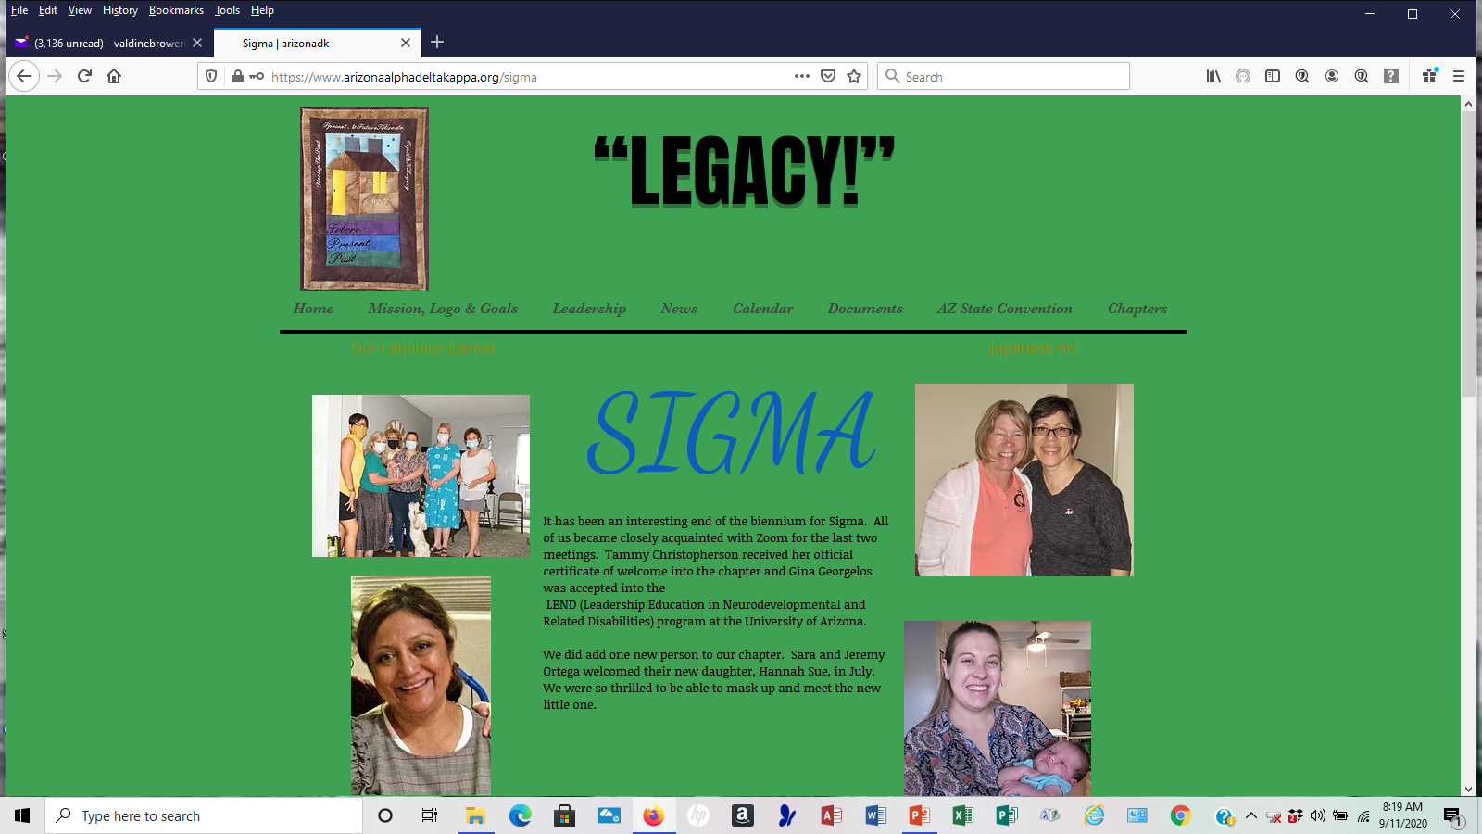
Chapter Page

Slide 9
Questions? Call, text or email me at 505-979-0197 valdinebrower@yahoo.com or azadkvbwm1@gmail.com
Valdine Brower
Arizona Webmaster
2020-2021
https://www.arizonaalphadeltakappa.org

